Slide 1
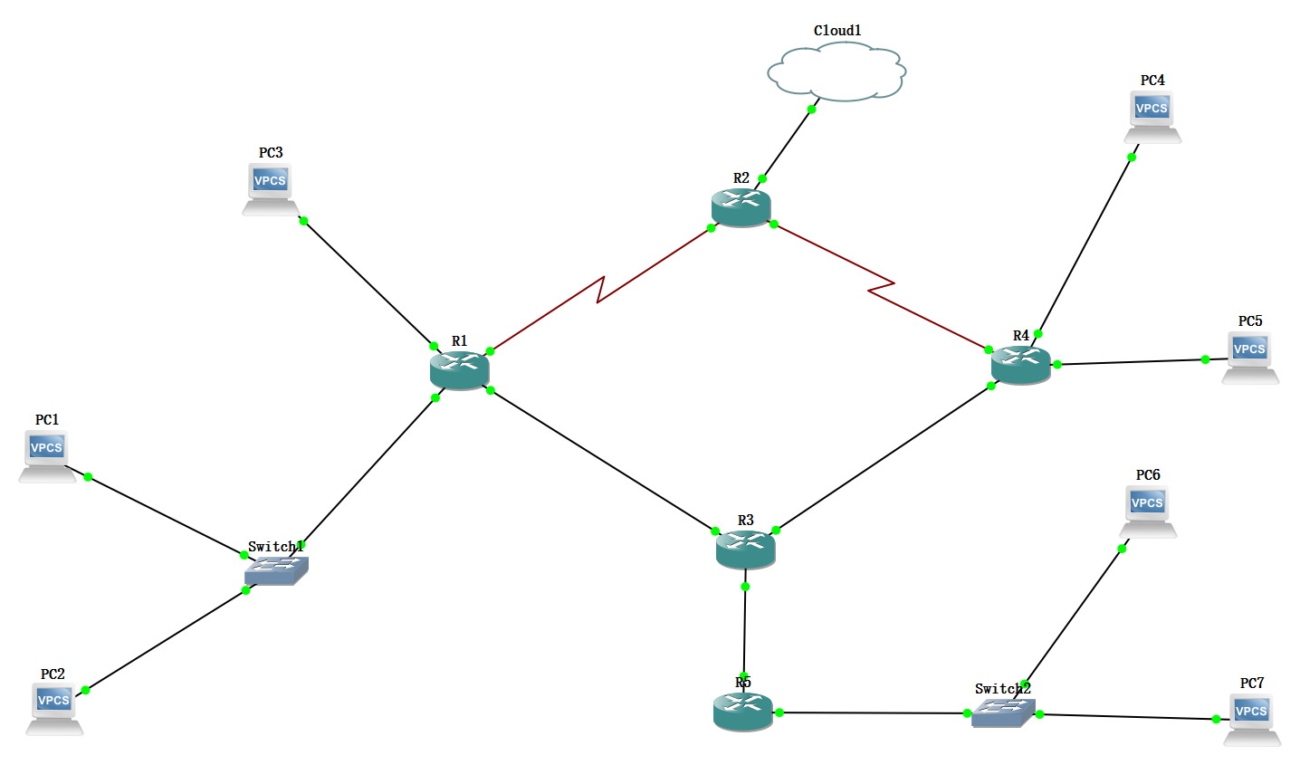
R1
fa0/0 10.0.0.1/16
fa1/0 10.0.0.1/16
fa0/1 192.168.13.1
s0/3 192.168.12.1
R2
s0/3 192.168.12.2
s3/1 192.168.24.2
R3
fa0/1 192.168.13.3
fa1/0 192.168.34.3
fa0/0 192.168.35.3
R4
s0/1 192.168.24.4
fa1/0 192.168.34.4
fa0/0 172.16.0.1
fa0/1 172.16.1.1
R5
fa0/0 192.168.35.5
fa0/1 192.168.0.1
External
eth2
ip:10.1.0.42
fa0/0
ip:172.16.0.2
zone2
s3/0
s3/1
Guest zone
fa1/0
s3/0
fa0/0
ip:172.16.0.2
s3/1
fa0/1
fa0/0
fa0/1
ip:10.1.0.42
fa1/0
e0
ip:192.168.0.42
fa0/1
fa1/0
e0
fa0/0
Private zone
zone1
ip:192.168.0.42
e0
fa0/0
e1
fa0/1
e0
e2
e0
ip:10.1.0.42

